Slide 1



Intern Presentation
Incorporating Weather Data for PUE Prediction in LaRC Data Centers
Sam Briggs
01/16/24

Slide 2







About Me
Machine Learning Engineer Intern here at NASA Langley Research Center (LaRC) for Fall 2023
Master’s student in Computational Linguistics @ University of Washington (UW)
Machine learning (ML) applications for natural language
Intersection between Linguistics and Computer Science
Branch of linguistics that includes natural language processing (NLP)
Previous:
Bachelor of Arts in Mathematics & Linguistics @ UW
NLP/ML engineer Intern at Customer Relations Management start-up
Next:
NLP/ML engineer Intern at the AMES Research Center for NASA
Graduating Spring 2024
1.
Fig 1. University of Washington. “The purple Block W logo of the University of Washington.” 4 Feb, 2018, https://en.wikipedia.org/wiki/File:University_of_Washington_Purple_Block_W_logo.svg. Retrieved 3 Jan. 2024

Slide 3
Agenda
Project Introduction
Weather Data:
Sources
Automation
Power Usage Effectiveness (PUE) Modeling:
Data engineering
Models
Model Optimization
Results

Slide 4
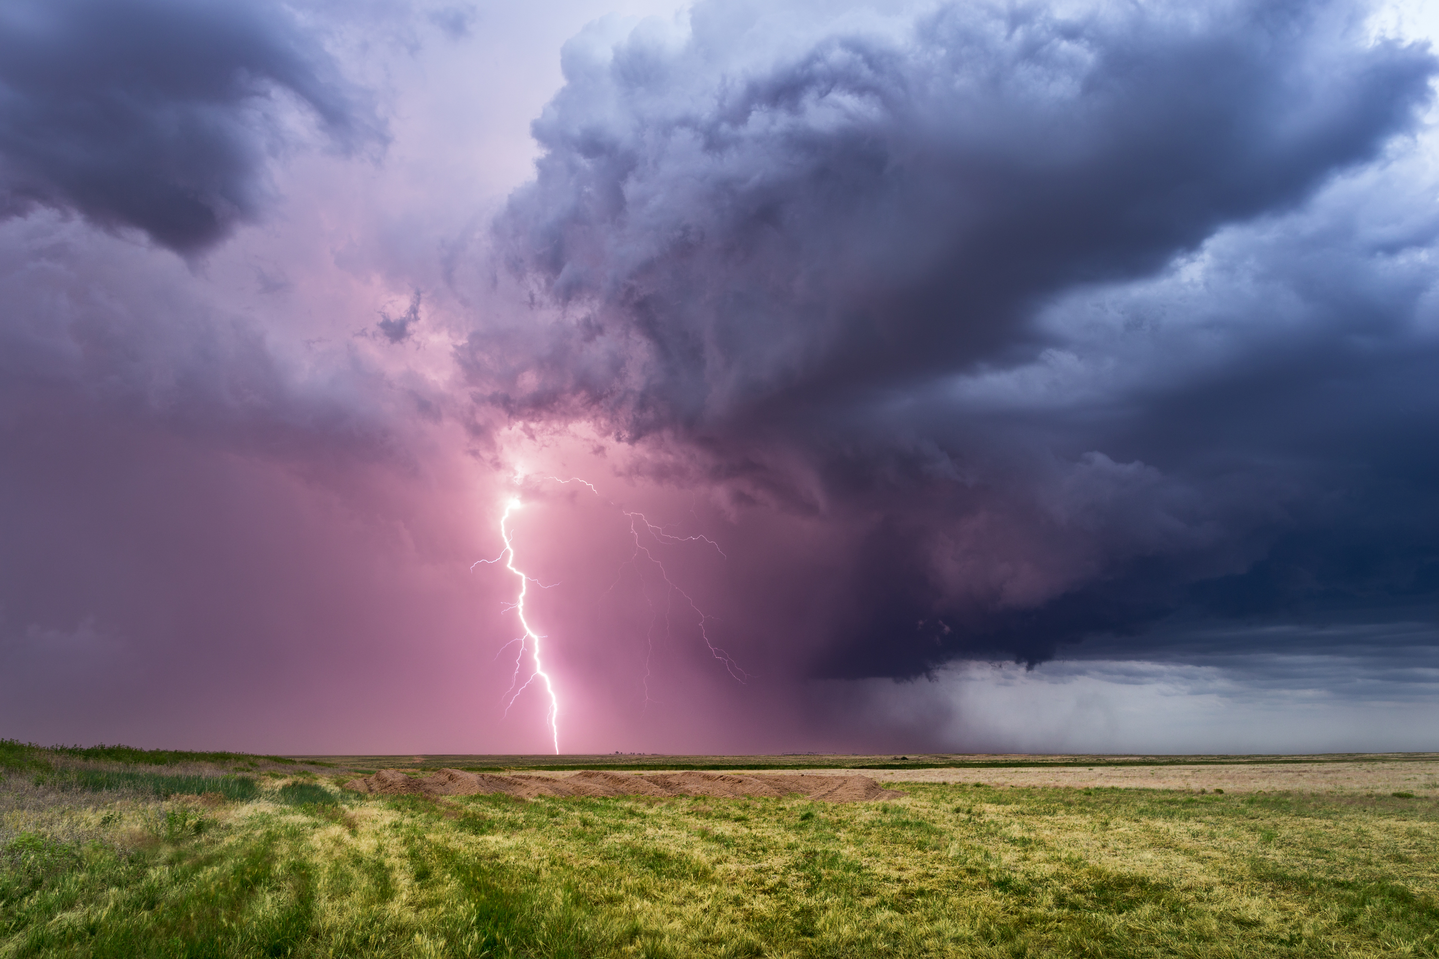
Project Introduction
My project had two main parts:
Collecting LaRC local environmental weather data
Model/estimate PUE using Machine Learning (ML) models
Incorporate weather data into ML models
1.
Fig. 1: Image from Microsoft Version 2208
Notes:
**ANY QUESTIONS**

Slide 5
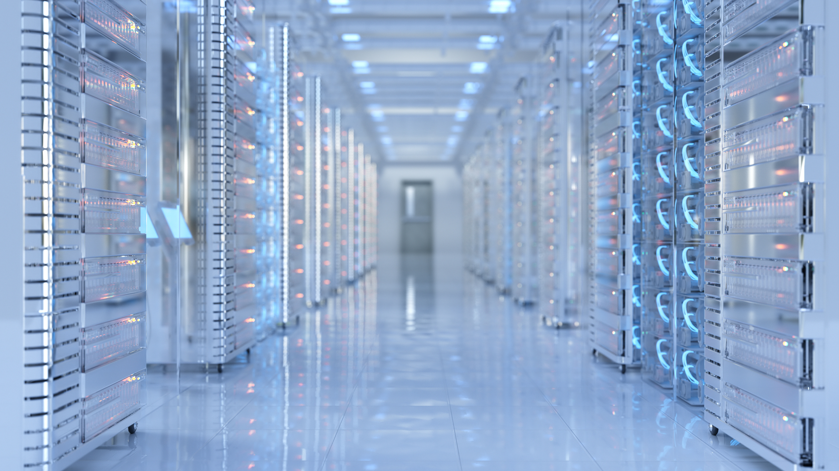
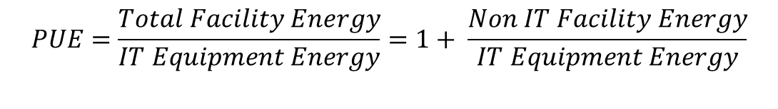
PUE
What is PUE?
Power Usage Effectiveness (PUE): a metric used to measure the efficiency of a data center’s energy consumption.
Ideally, all the energy of a data center would be used to power the computing equipment, rather than for the cooling, heating, lighting, etc.
Ideal PUE is 1.0
$$PUE=\frac{Total Facility Energy}{IT Equipment Energy}=1+ \frac{Non IT Facility Energy}{IT Equipment Energy}$$
1.
Fig. 1: Image from Microsoft Version 2208
Notes:
**ANY QUESTIONS**

Slide 6
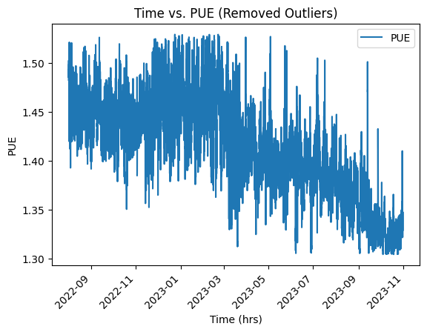
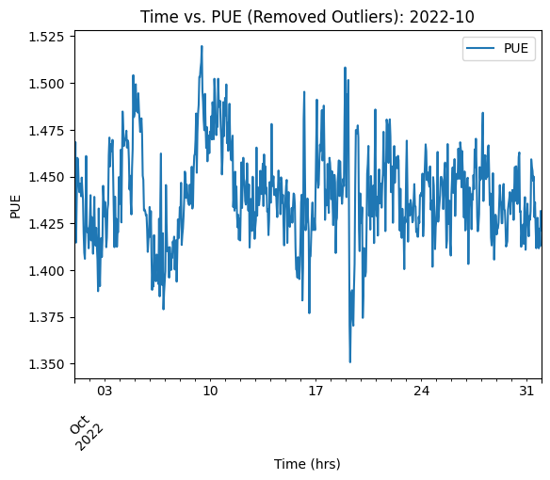
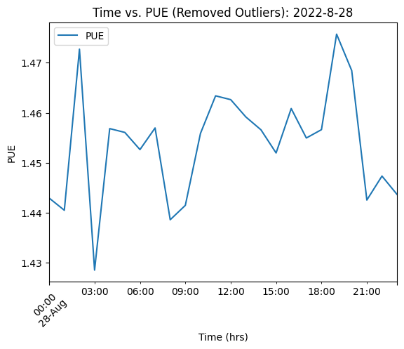
Problem Motivation
Decrease PUE to create efficient data centers
How do we best use pumps, chillers, place thermal tiles, etc.?
PUE fluctuates/varies. A lot!
PUE is highly dependent on environmental factors
How do we flatten the fluctuations?
Data center consolidation
Decisions about which data centers to shut down, which to expand, etc.
Notes:
Whole year
Month – October 2022
Day - August 28th 2022
Data center consolidation:
Modeling the PUE can help us figure out which aging and inefficient data center infrastructure to phase out in favor of new more efficient infrastructure.

Slide 7
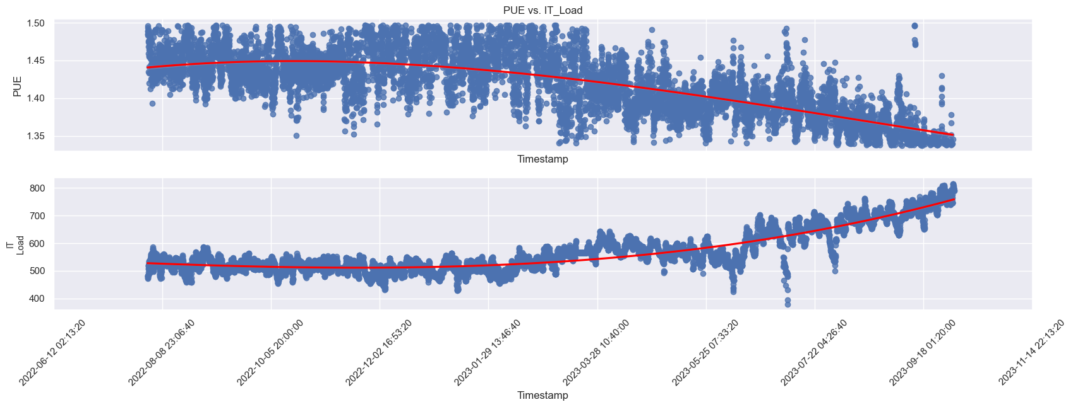
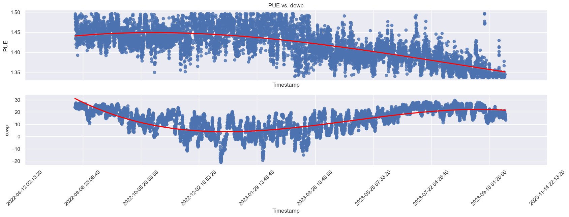
Problem Context
Why is this a hard problem?
PUE data fluctuates and varies greatly over time
Limited PUE and data center data
Only have data from 08/01/2022
Data center configuration constantly changing
IT Load correlated to PUE
Even thermal tile placement greatly impacts the PUE
PUE highly subject to the current environment, e.g., weather
Notes:
Only started collecting data from August the 1st 2022…
Dewpoint in degrees Celsius
Danny Morris moved thermal tiles
IT load
**ANY QUESTIONS**

Slide 8
Agenda
Project Introduction
Weather Data Collection:
Sources
Automation
PUE Modeling:
Data
Model engineering
Model Optimization
Results

Slide 9
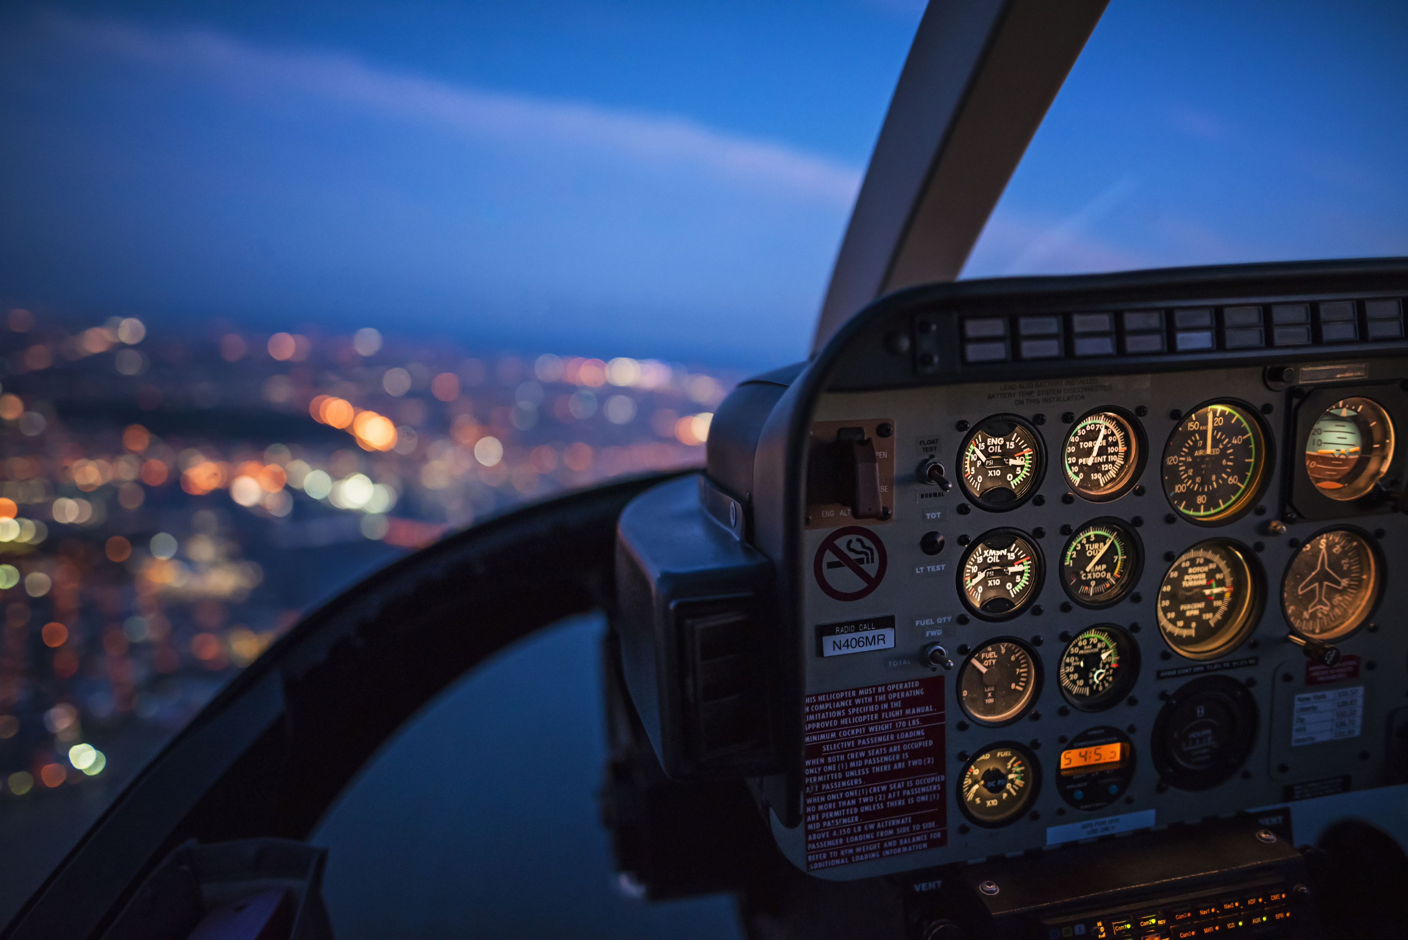
Weather Data Sources
Langley Air Force Base (LAFB) (ICAO: KLFI)
Just next door to LaRC!
METeorological Aerodrome Report (METAR)
Encoded hourly weather data pertinent to flying, e.g., temperature, dewpoint, wind speed, pressure, precipitation, etc.
Automatically produced weather encodings
Terminal Aerodrome Forecast (TAF)
Issued about every 6 hours
Forecast good for the next 24 to 30 hours for about a 5 mile radius of LAFB
Created manually by a weather forecaster
1.
Fig. 1: Image from Microsoft Version 2208
Notes:
We decided to use LAFB weather data and not PI data because we wanted this to be extensible to other NASA centers. Many NASA centers are attached to an air force base.

Slide 10
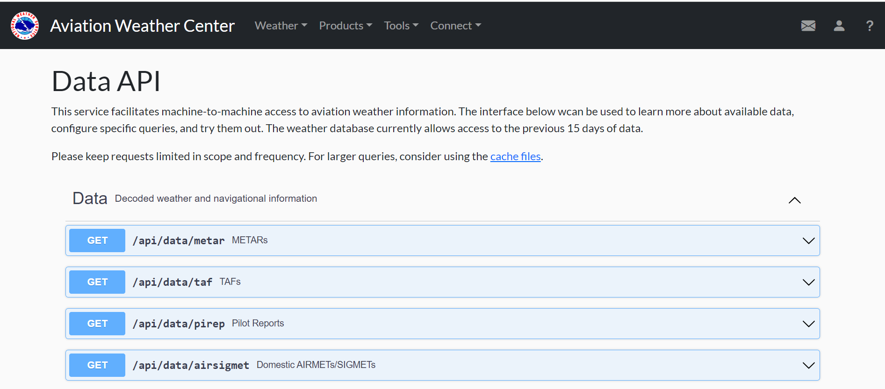
Aviation Weather Center
Aviation Weather Center (AWC) provides weather updates for the purpose of aviation.
Data API
The Aviation Weather Center hosts their own data API @ aviationweather.gov/data/api
Pull aviation related weather for the last 15 days using Python code!
Returns Json files!
Notes:
***ANY QUESTIONS***

Slide 11
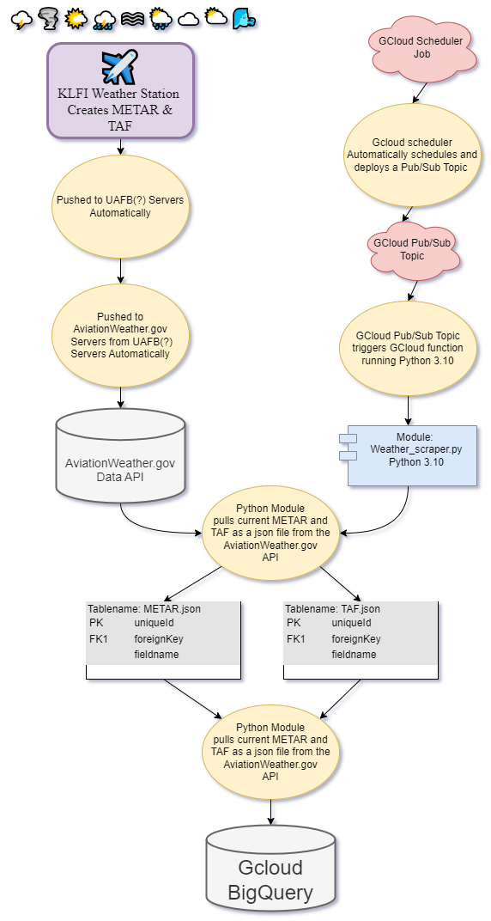
Automated Weather Data Collection
Gcloud Scheduler
Creates the Gcloud pub/sub topic once every hour
Gcloud pub/sub topics
Triggers the Gcloud function
Gcloud functions
To run python script which pulls weather data Json file from aviationweather.gov data API
Gcloud Source Repositories
For versioning and version control
Gcloud BigQuery
To store the weather data
TODO: Deployment!
Notes:
WORK ON THIS SLIDE
Can be handled using python code on home computer or NASA server.
Experimented with Gcloud for OPEN SOURCE data, inexpensive, extensible for other open source data models.
**ANY QUESTIONS**

Slide 12
Agenda
Project Introduction
Weather Data Collection:
Sources
Automation
PUE Modeling:
Data Engineering
Model engineering
Model Optimization
Results

Slide 13
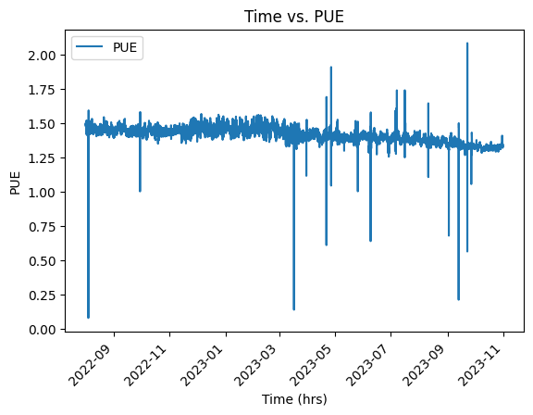
Data Center Energy Consumption Data
Just over 1 year of data center energy consumption data
From 08/01/2022 – 10/31/2023
Data includes energy consumption and data center configuration
water pumps, chillers, cooling fans, heaters, etc.
Most importantly, includes the PUE!
Sample hourly readings of PUE and data center conditions.
Joined with the hourly weather METAR data!
Data corresponding to PUE outliers in the bottom 2% and top 2% were removed
Notes:
Metrics about energy consumption as well as configured settings for individual components in the data center
Sensor data drop-out in PI data
Often, take the mean between two known values for unknown value for sensor dropout

Slide 14
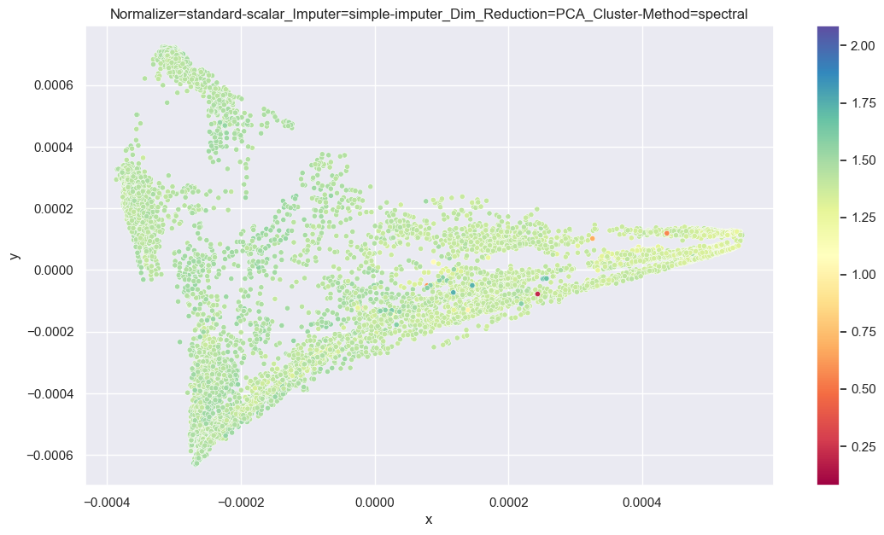
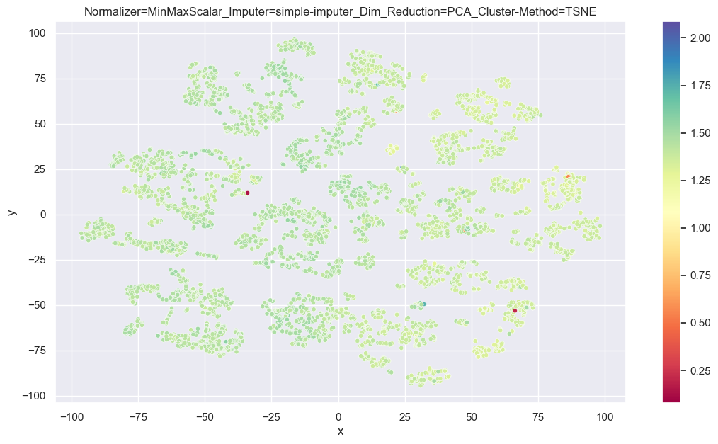
Data Visualization
Can we make sense of the joint dataset?
Dimensionality Reduction & Data visualization techniques…
Notes:
Make sure to mention that color coding is PUE
Normalizers:
Minmax scalar: fits within range [-1, 1]
Standard Scalar: Removes the mean and scaling to unit variance.
Imputers:
Simple Imputer: Fill nan values with -1
Dim Reduction:
Principal component analysis (PCA). From sklearn documentation: “Linear dimensionality reduction using Singular Value Decomposition of the data to project it to a lower dimensional space.”
Cluster Method:
T-distributed Stochastic Neighbor Embedding (TSNE): From sklearn docs: “It converts similarities between data points to joint probabilities and tries to minimize the Kullback-Leibler divergence between the joint probabilities of the low-dimensional embedding and the high-dimensional data.”
SpectralEmbedding: ): From sklearn docs: “Forms an affinity matrix given by the specified function and applies spectral decomposition to the corresponding graph laplacian. The resulting transformation is given by the value of the eigenvectors for each data point.”

Slide 15
Feature Engineering
This data does NOT contain information about changes to the data center, e.g.
IT Load
Replacement of old inefficient hardware
Reconfigured thermal tiles
Problem: How do we get a model to expect such changes in infrastructure, or usage patterns and continue to be able to accurately predict the PUE?
Notes:
**ANY QUESTIONS**

Slide 16
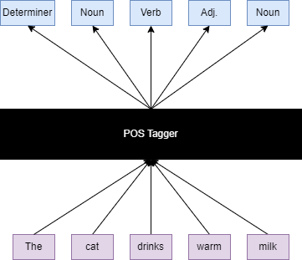
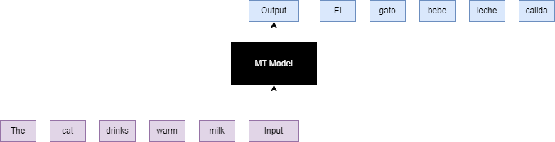
Approach
Problem: Given n timesteps worth of data, can we predict the next n timesteps of PUE?
As a computational linguist…
I thought of this as a supervised problem, we already have the PUE!
I thought of this problem as a machine translation (MT) problem, or part-of-speech (POS) tagging problem
One time stamp of data (both data center consumption & weather data) is analogous to a word embedding
Word embedding: A vector representation of an individual word capturing semantic information about that individual word.
The sequence of next n timesteps of PUE is analogous to the translated sentence, or the sequence of part-of-speech tags!
Notes:
***Any Questions***

Slide 17

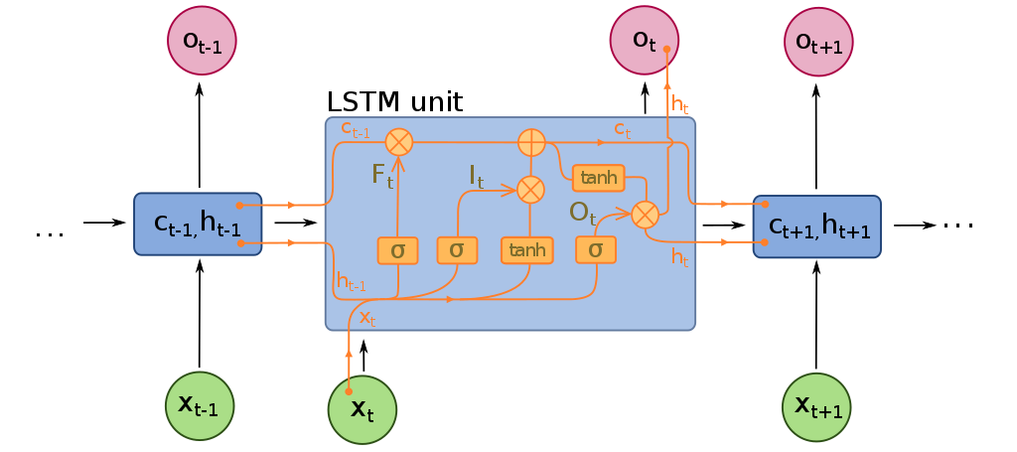
RNNs
Recurrent Neural Networks (RNN) work with sequential data
Two types of RNNs: Vanilla RNN vs. Long Short-Term Memory (LSTM)
1.
2.
Fig 1. fdeloche, CC BY-SA 4.0 <https://creativecommons.org/licenses/by-sa/4.0>, via Wikimedia Commons, https://upload.wikimedia.org/wikipedia/commons/b/b5/Recurrent_neural_network_unfold.svg
Fig 2. fdeloche, CC BY-SA 4.0 <https://creativecommons.org/licenses/by-sa/4.0>, via Wikimedia Commons, https://upload.wikimedia.org/wikipedia/commons/6/63/Long_Short-Term_Memory.svg
Notes:
***ANY QUESTIONS***

Slide 18
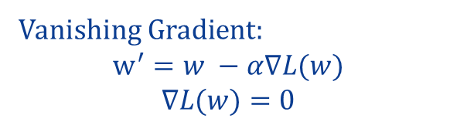
Models
Vanilla Recurrent Neural Network (RNN)
One weight matrix
Con: Vanishing/Exploding Gradient Problem
Con: Only able to rely on the previous timestamp
Sequence to Sequence Long Short-Term Memory (Seq2Seq LSTM)
Seq2Seq architecture contains an encoder and a decoder (two weight matrices instead of one)
LSTM: Solves Vanishing/Exploding Gradient Problem
LSTM: Memory cell retains information from much earlier timestamps
Both
Recurrent Neural Network architectures
Input: timeseries sequence of N timestamps of data
Output: corresponding predicted sequence of PUE
Loss: Used Mean Squared Error
Vanishing Gradient:
$$w^{′}=w −α∇L(w)$$
$$∇L(w)=0$$
Notes:
Stock photo of gradient descent
***ANY QUESTIONS***

Slide 19
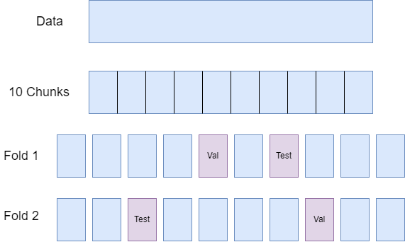
Hyper-parameter Tuning: Validation
Testing different hyper-parameter combinations
K-Fold Cross Validation (K = 5)
Split the data into 10 even chunks
Choose one chunk as the test set
Choose a different chunk as the validation set
Remaining 8 chunks concatenated as train set
For each fold:
Trained on train set
Inferenced on the validation and test set
Loss scores between folds were aggregated (mean) to account for run variability
Notes:
Because this is timeseries data, it is important that chunks are not shuffled.
***Any Questions***

Slide 20
Hyper-parameter Tuning: Random Search
Why Random Search
Hyper-parameter search space is very large
Using K-Fold Cross Validation (multiplied # of combinations by K)
Only used CPU
Random search randomly picks a subset of hyperparameter combinations
Vanilla RNN: tried 20 different models
Seq2Seq LSTM: tried 88 different models
Notes:
***Any Questions***

Slide 21
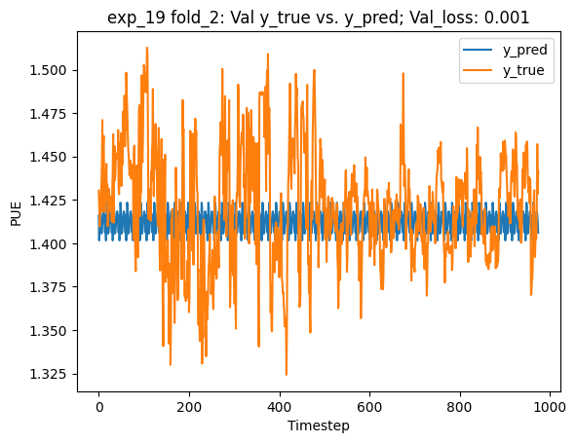
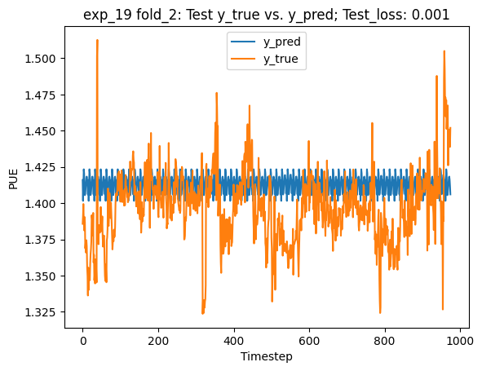
Results
Sometimes good loss scores do not mean good results
Model would perform well when only predicting the mean PUE score over the whole val or test set
Notes:
Explain title notation
Remind:
Training on training data
Validation results on left side, test results on right side (brand new data)

Slide 22
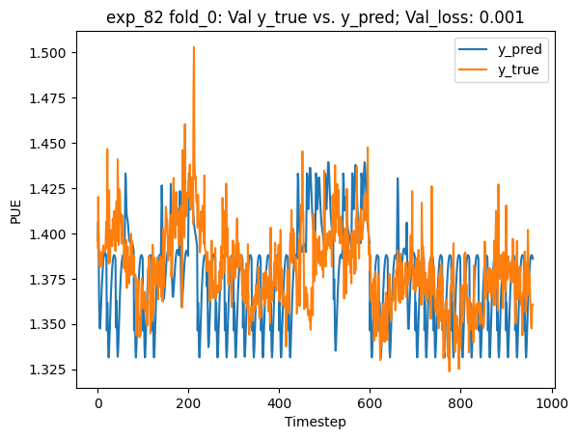
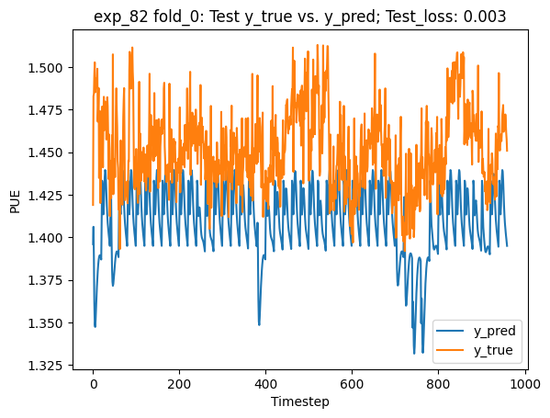
Results II
Sometimes results varied very widely between folds

Slide 23
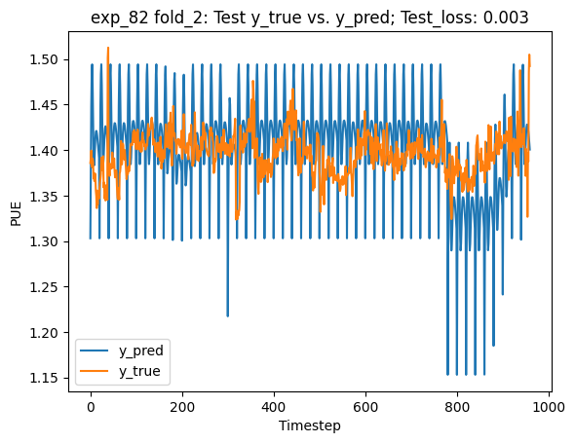
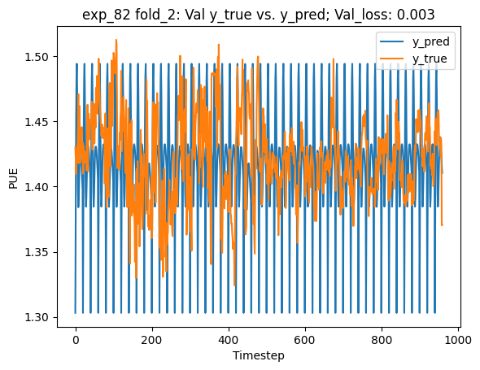
Results II
Sometimes results varied very widely between folds

Slide 24
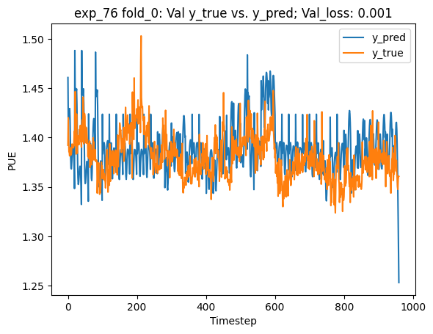
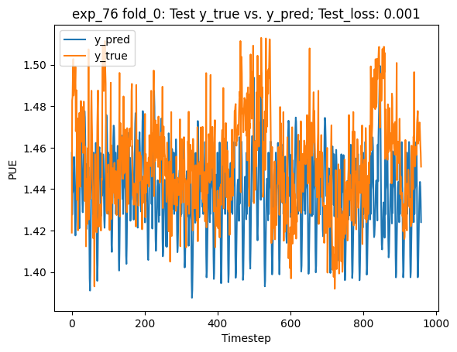
Results III
Sometimes results look pretty good

Slide 25
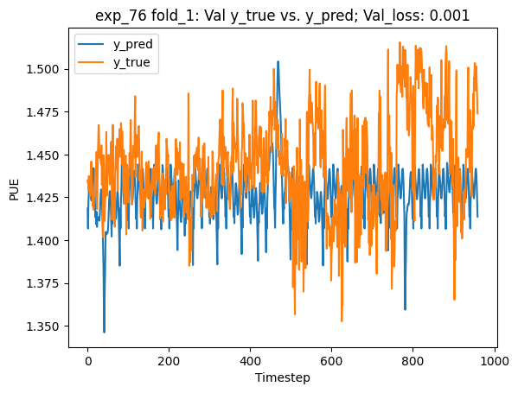
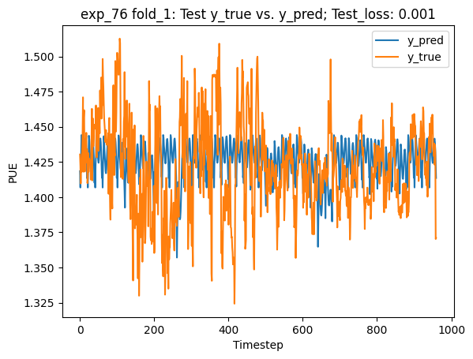
Results III
Sometimes results look pretty good

Slide 26
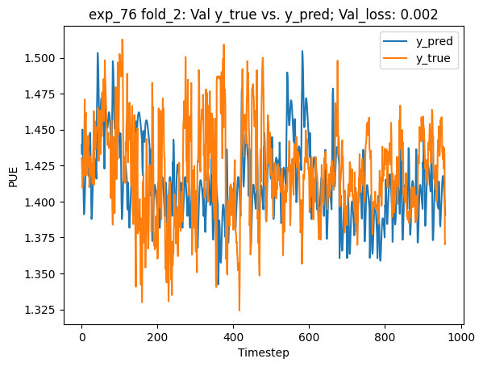
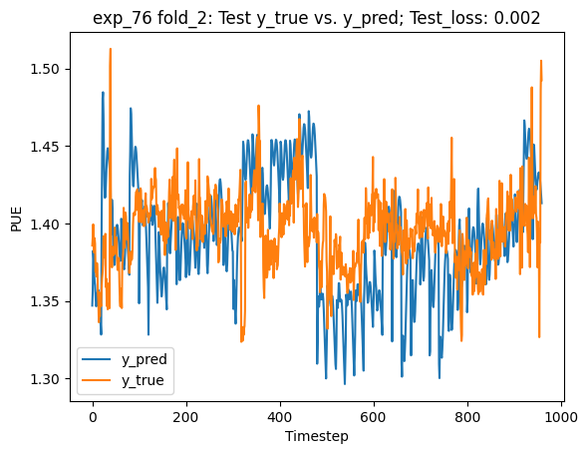
Results III
Sometimes results look pretty good

Slide 27
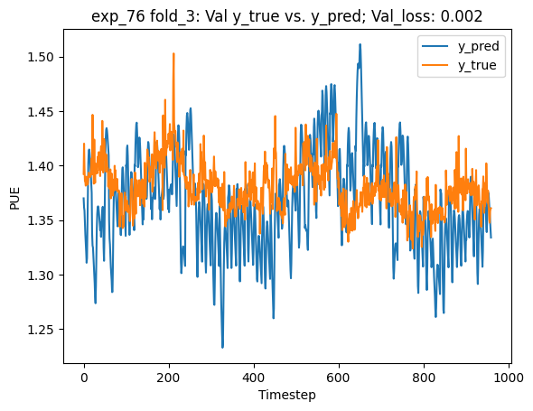
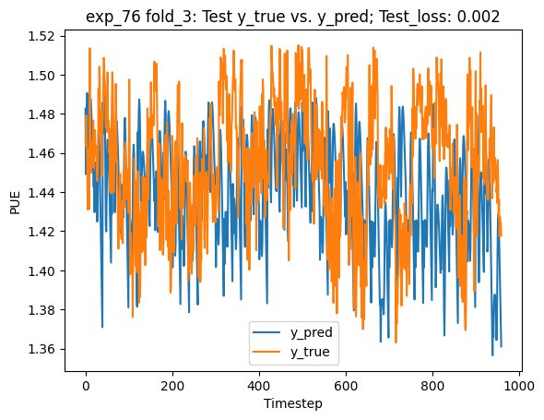
Results III
Sometimes results look pretty good

Slide 28
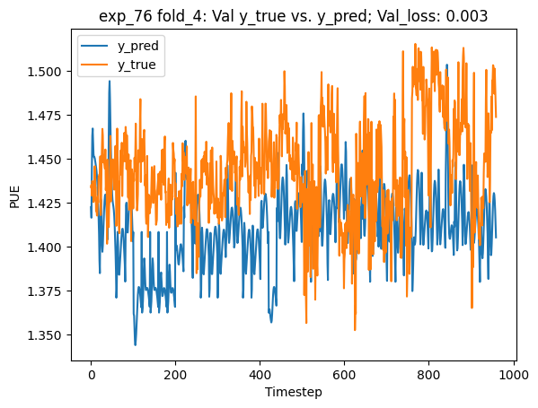
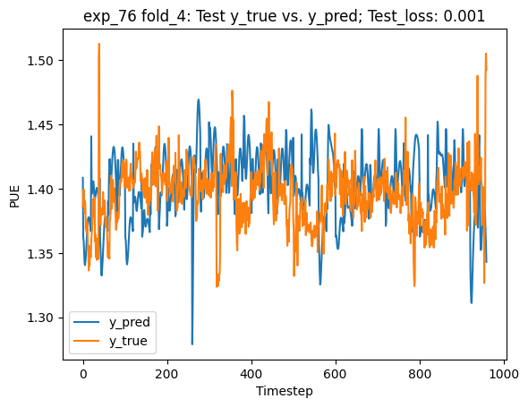
Results III
Sometimes results look pretty good

Slide 29
Results IV
You may have noticed the predicted PUE fluctuates quite a bit and is very “spiky”
Hypothesis: The PUE data fluctuates quite a bit → model has learned this behavior
This could be a problem
Notes:
***ANY QUESTIONS***

Slide 30
Future Work
Do more thorough examination of salient and pertinent weather features
Other inputs
Is it a work day? Is it evening?
Figure out which hyper-parameters affect the model performance the most
Try other models such as a transformer model
Consider new model features to account for data center reconfiguration
e.g., What happens to the PUE if we add a new data server?
Notes:
Create simpler models where we can model changes in the data center
We did not try other inputs because the data center has been running at full capacity starting since COVID. HVAC system to flush out virus

Slide 31
Acknowledgements
Many thanks to…
Charles Liles, Project Mentor
Langley Transformation Initiative
LaRC Center Operations Directorate
LaRC Integrated Operations Center
Guardians of Honor
Mark Pugh, Stephen Fehr, Danny Morris for meeting Charles and I to discuss the data center energy consumption and how to better model PUE
Mike Mueller and his son Thomas Mueller for getting me a working NASA laptop after everything that happened
Feel free to reach out!
99samb@gmail.com
briggs3@uw.edu
Linkedin.com/in/samuelbriggs31
Notes:
Langley Transformation Initiative (funded)
LaRC Integrated Operations Center (Make decisions for maintenance based on data)

Slide 32
EXTRA SLIDES

Slide 33
References

